Slide 1
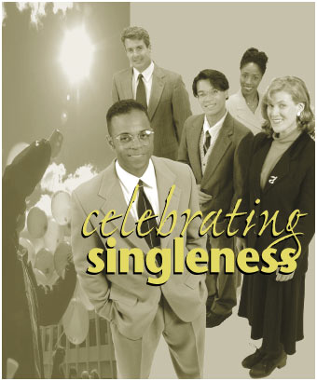
Why Stay Single?
Why Stay Single?
1 Corinthians 7:25-40
Dr. Rick Griffith • Crossroads International Church Singapore
cicfamily.com & BibleStudyDownloads.org

Slide 2

"Don't make major changes during a crisis"

Slide 3
2013
1943

Slide 4
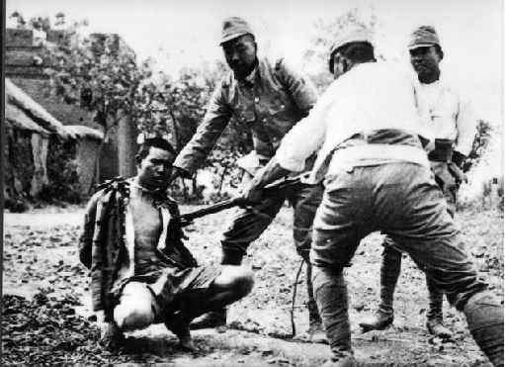
Japanese Occupation of Singapore

Slide 5

Black

Slide 6
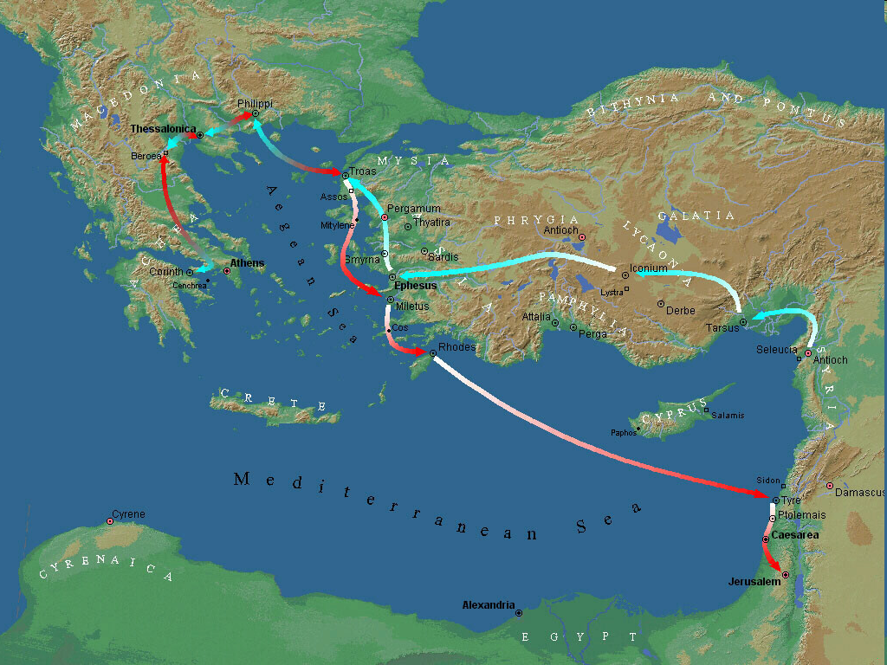
Third Missionary Journey Map
“Present crisis” at Corinth (7:26)
Corinth
Third Missionary Journey
A.D. 53-57

Slide 7

1 Corinthians 7 Overview
“Remain”
17, 20, 24
Marriage
7:1-24
Singleness
7:25-40

Slide 8

Groups Addressed
Marrieds (1-7)
Widows (8-9)
Divorcees (10-11)
Those Thinking About Divorce (12-16)

Slide 9
1 Corinthians 7 Main Idea
Marriage, a new physical appearance or work status won't make you happy—but being content with the state God placed you will!

Slide 10
Black

Slide 11

Why Stay…
Single?

Slide 12
Black

Slide 13

I. Singleness has its advantages (28b-35).

Slide 14
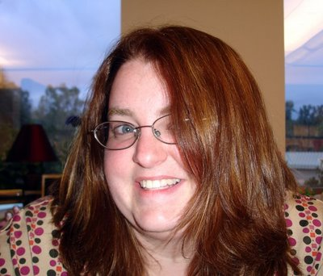
A. Trials: Singles have fewer troubles than married folks (28b).
Why stay single?

Slide 15
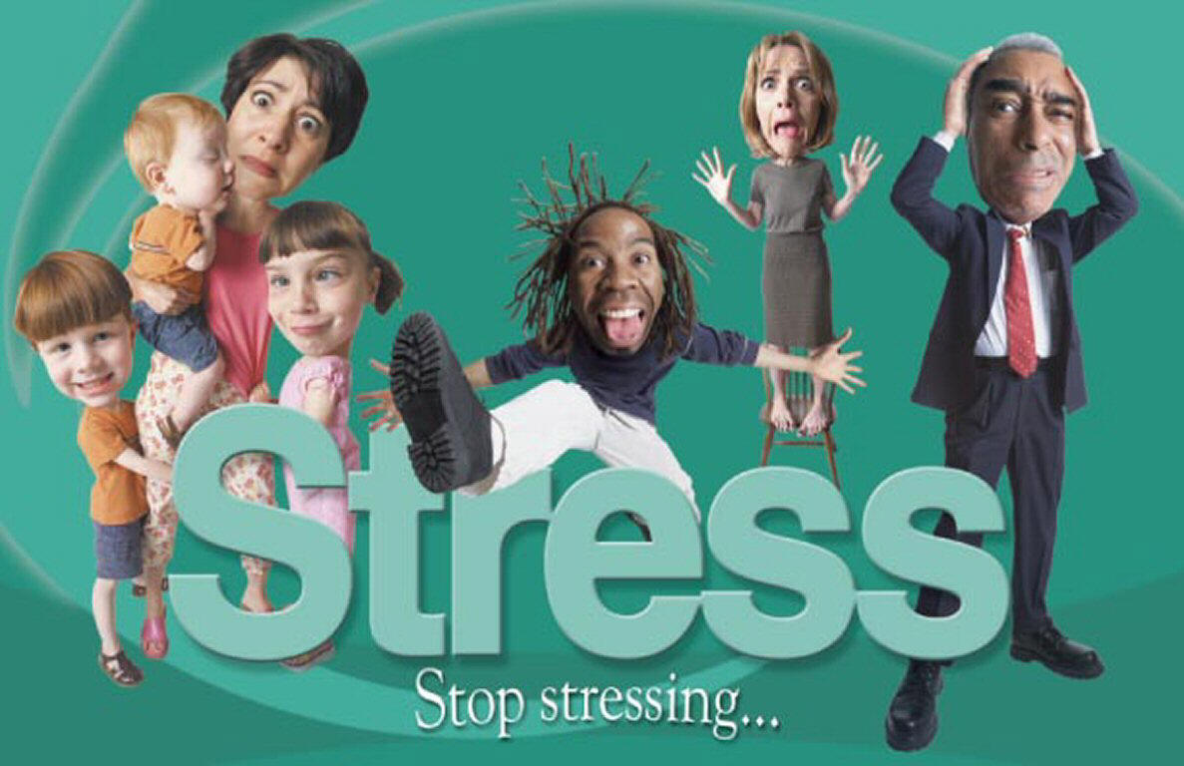
Stress

Slide 16
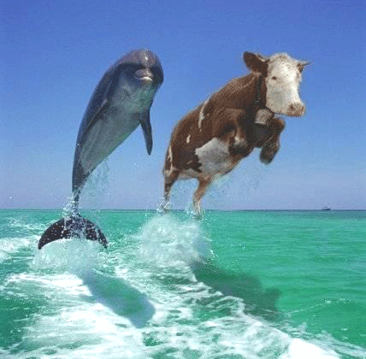

Cattleman's Stress Test
Notes:
The Stress-Test consists of viewing a photo of 2 Dolphins...�The dolphins appear to be nearly identical when viewed by stress-free individuals. The test is not sufficiently accurate to detect mild stress differentials, but is very accurate on individuals with higher stress-levels.�� �Deviations in appearance between the 2 dolphins are indicators of potential stress-related problems and the deviations, if any, may also indicate the source of stress.�� �If you experience significant deviations, you may want to consider taking things a little easier...

Slide 17
The Stress Scale
Death of Spouse
100
Death of Spouse
100
Divorce
73
Divorce
73
Marital Separation
65
Marital Separation
65
63
Death of Close Family Member
Social Readjustment Rating Scale (SRRS)
Thomas Holmes and Richard Rahe, 1967
Imprisonment
63
53
Personal Injury or Illness
Getting Married
50
Getting Married
50
47
Dismissal from Work
45
45
Marital Reconciliation
Marital Reconciliation
Notes:
In 1967, psychiatrists Thomas Holmes and Richard Rahe examined the medical records of over 5,000 medical patients as a way to determine whether stressful life events might cause illnesses. Patients were asked to tally a list of 43 life events based on a relative score. A positive 0.1 correlation was found between their life events and their illnesses. Thus, the Social Readjustment Rating Scale (SRRS) or the Holmes and Rahe Stress Scale was born. However, this study can be perceived as unreliable since it asks participants to look back at their life events, making the data retrospective.
See Holmes, T.H. and Rahe, R.H.: The social readjustments rating scales, Journal of Psychosomatic Research, 11:213-218, 1967
Source: http://en.wikipedia.org/wiki/Holmes_and_Rahe_stress_scale

Slide 18

Stress Ball

Slide 19
Black

Slide 20

B. Time: Singles have more time to invest in eternal matters
(29-31).
Why stay single?

Slide 21
Black

Slide 22







Women on SBC Faculty in 2008

Slide 23

Pornography in America
Highest Cities
Washington DC
7 porn videos viewed/year
14 porn videos viewed/year
50% residents married
25% residents married
Source: Newser.com 11 Jan 2013
Notes:
Newser: "A report by Buzzfeed and leading porn site Pornhub says that Washington DC is the top spot in America for watching online smut…
(Newser) – If the Midwest is America's heartland, apparently Washington, DC, is a somewhat lower-positioned organ. Leading smut website PornHub.com has announced that the nation's capital is the US leader when it comes to watching porn, as compared to the 50 states, reports the Washington Post. In fact, DC residents watch nearly twice as much pornography as any other state—an average of 14.18 videos a year per person, compared to 7.57 videos a person in Hawaii, 7.52 in Massachusetts, and 7.5 in New York. The Post suggests that perhaps one reason for the city's ranking is that it is so single, with just a quarter of DC residents married, or about half the rate of the rest of the country. Check out an infographic filled with other porn-viewing stats at BuzzFeed (http://www.buzzfeed.com/alannaokun/washington-dc-residents-watch-more-porn-than-anyon)" Link at Newser: http://www.newser.com/story/160800/washington-dc-is-no-1-at-watching-online-porn.html

Slide 24
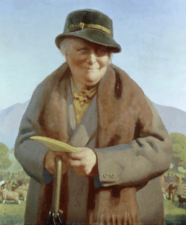
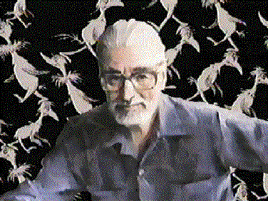
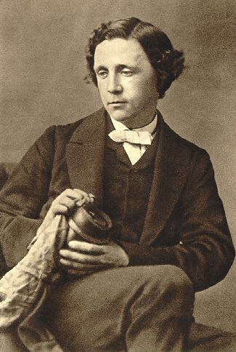

Children's Authors
Beatrix Potter
Lewis Carroll

Slide 25
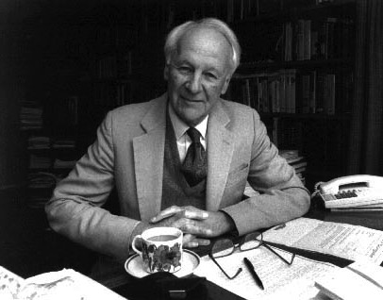
Other Singles
J.D. Douglas
Voltaire
Beethoven
Hans Christian Anderson
Michelangelo
John Stott

Slide 26
Black

Slide 27

C. Distractions: Singles can serve God in ways that those married can't
(32-35).
Why stay single?

Slide 28
Black

Slide 29
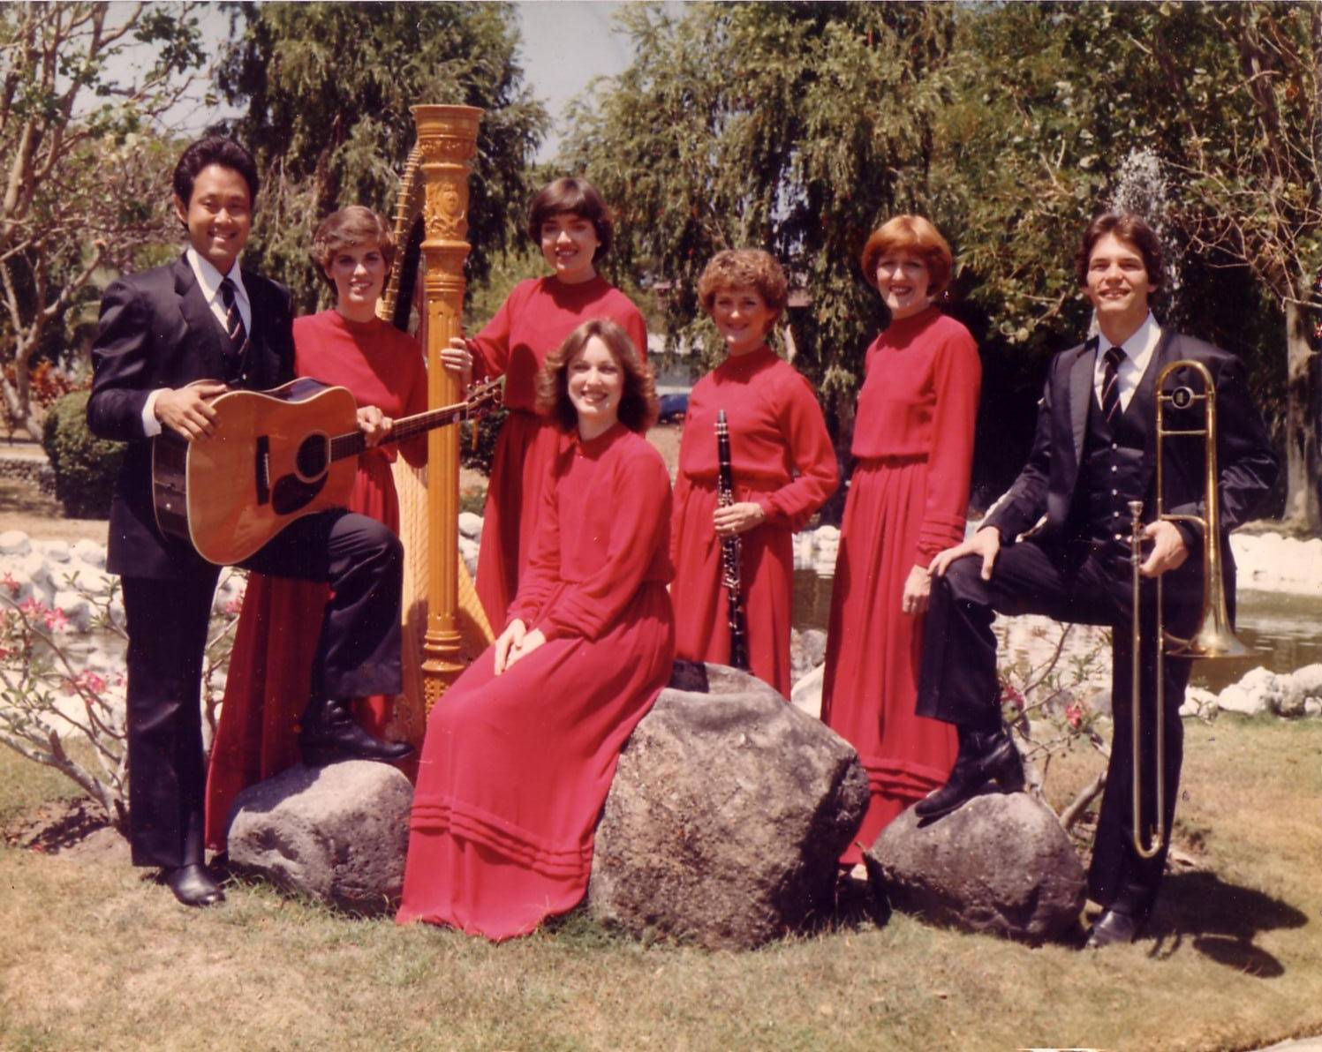
The Crossroads (1981-83)
Notes:
After college it seemed the natural thing to do to join Campus Crusade staff in the Philippines on a seven-member music team.

Slide 30
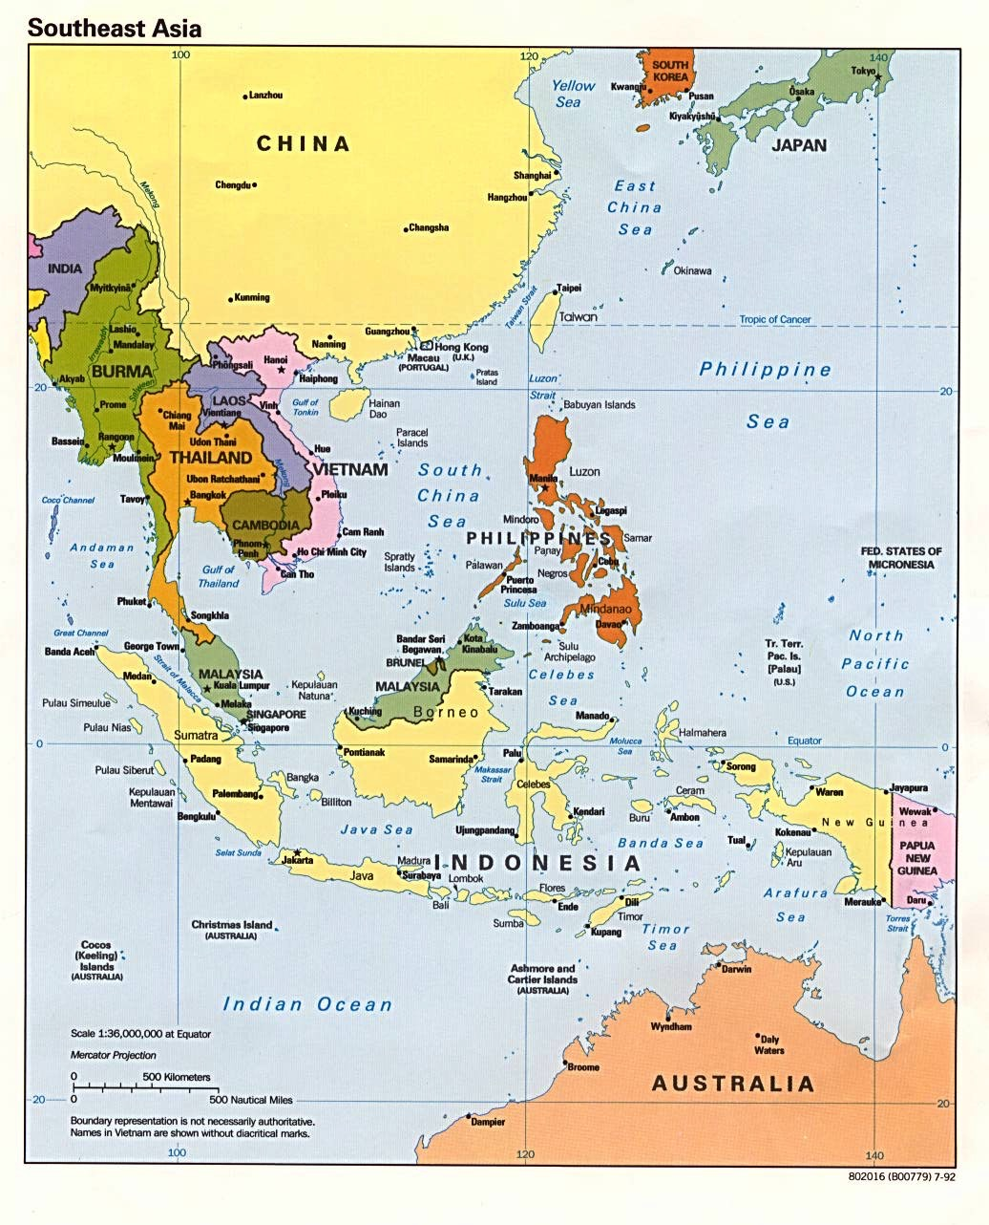
Crossroads Ministry
Korea
China
Japan
Hong Kong
Taiwan
Macau
Thailand
Philippines
Malaysia
Singapore
Indonesia
Notes:
The Crossroads team shared the gospel in 11 Asian nations and saw over 10,000 people indicate decisions to trust Christ! Again I was amazed at God's grace!

Slide 31
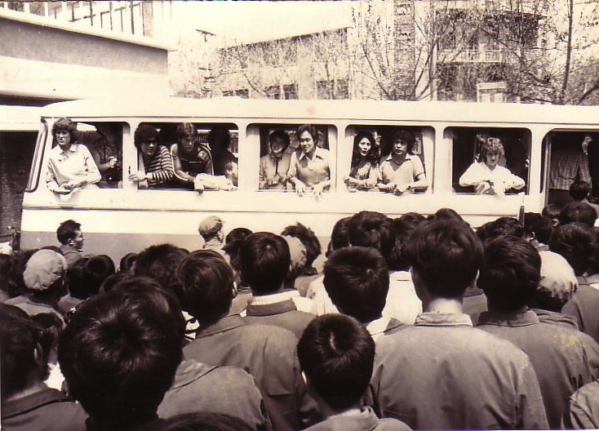
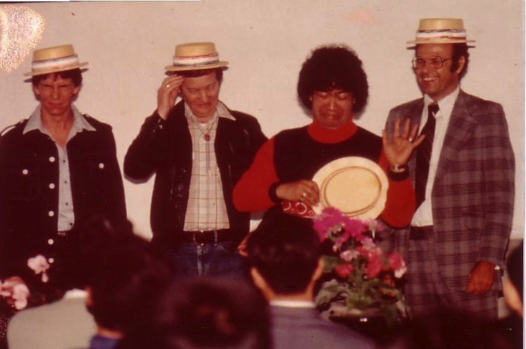
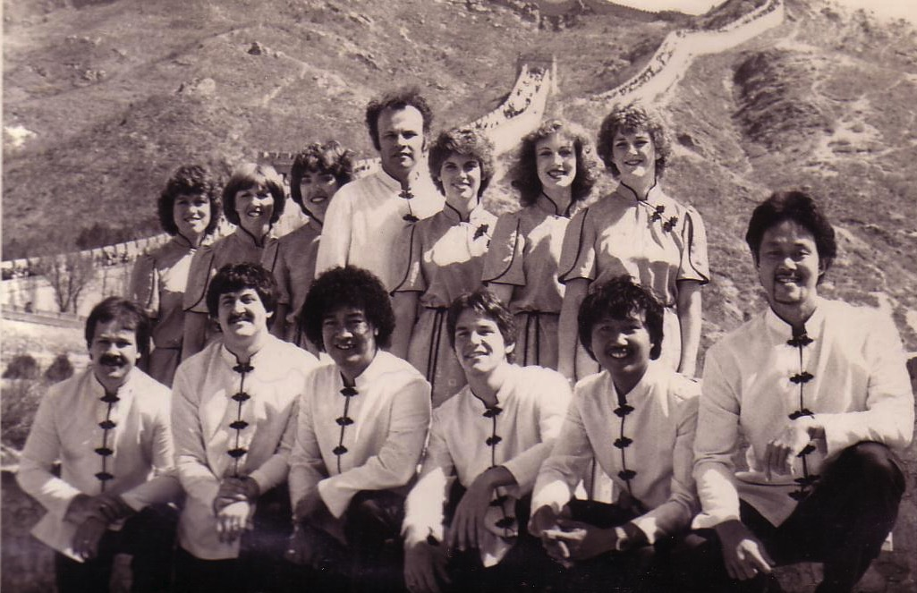
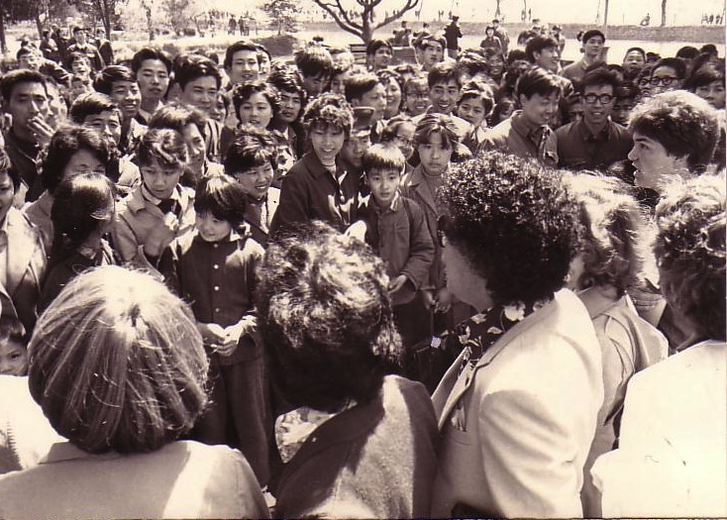
China, 1981
Notes:
Our first tour to China we were celebrities as the first Christian musical team to visit the New China. We sang in music conservatories, parks, and even from the bus! God began to open my eyes to the needs of East Asia…

Slide 32

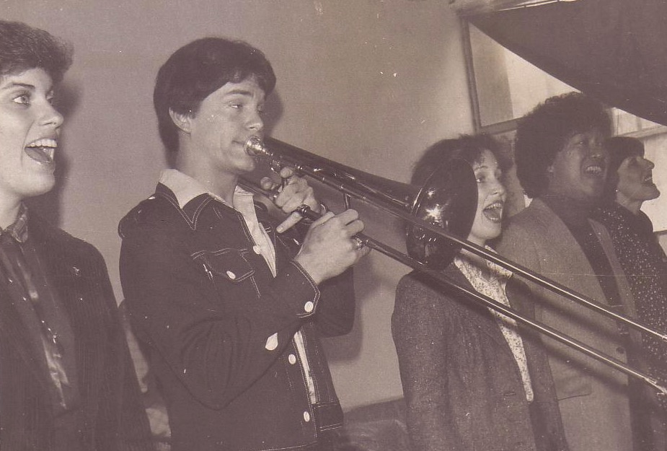
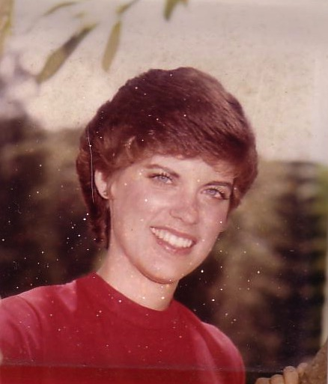
Susan & Me, 1982
Notes:
God also began to open my eyes to the woman singing next to me! She initially despised me but after a year or so she saw the light. That's our engagement picture. In 1983 we returned to the USA..

Slide 33
Black

Slide 34
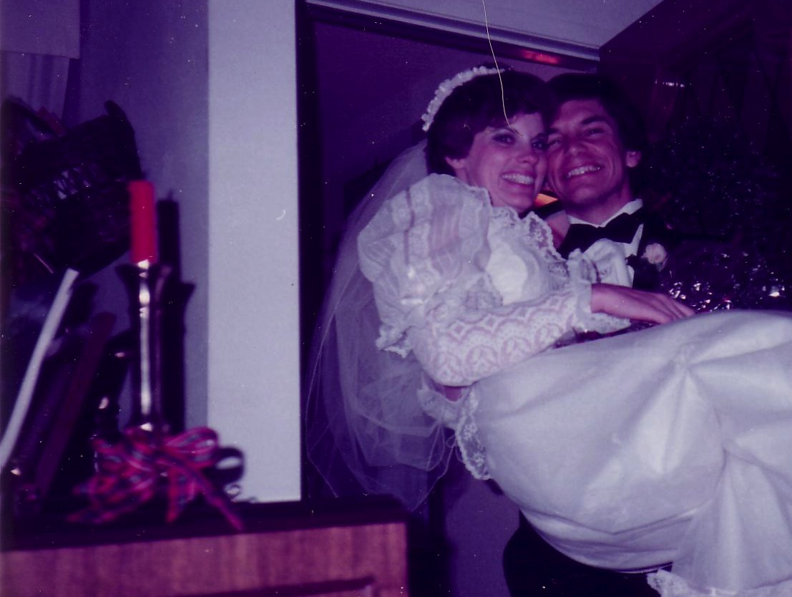
II. Marriage still isn't prohibited (36-40).
30 December 1983

Slide 35

A. Singles should get married if sexual temptation is too strong (36-38).

Slide 36
Black

Slide 37
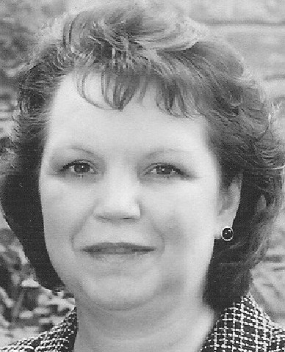
B. Widows can remarry too (39-40).

Slide 38
Black

Slide 39
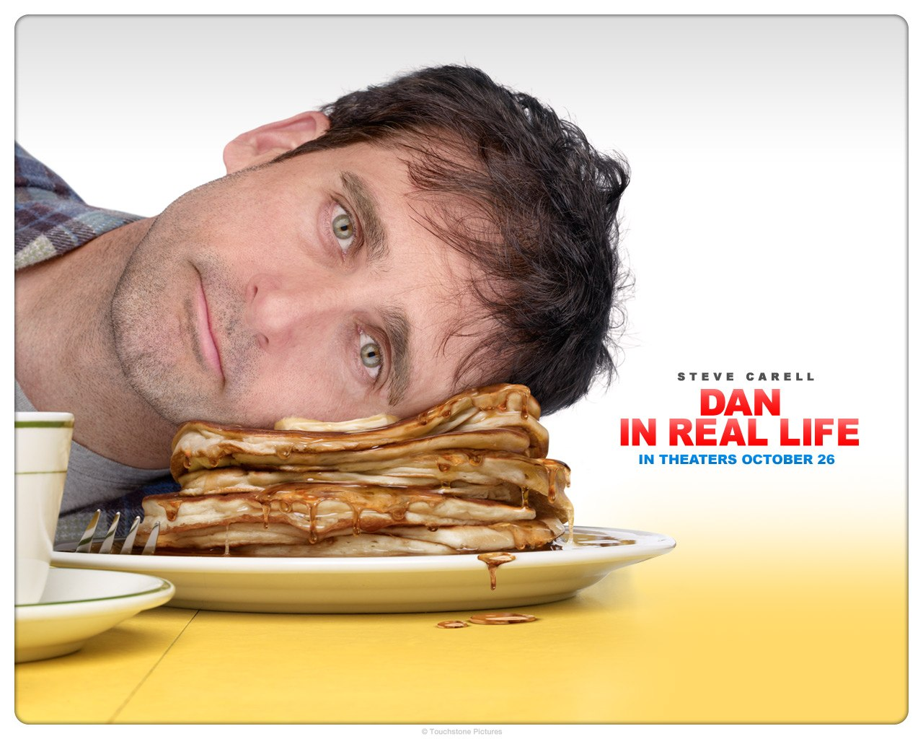
Single parenting ain't for sissies

Slide 40
Black

Slide 41
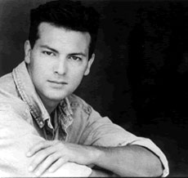
Main Idea
Singleness has its advantages (especially during difficult times) but marriage isn't prohibited.

Slide 42

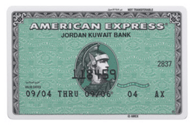
Non-
Membership has its privileges

Slide 43
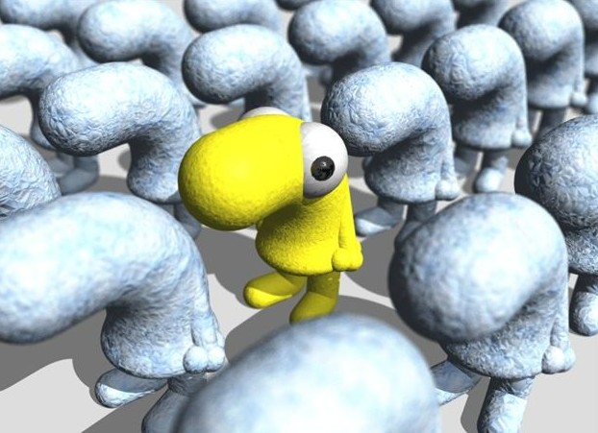
What about Singles?

Slide 44
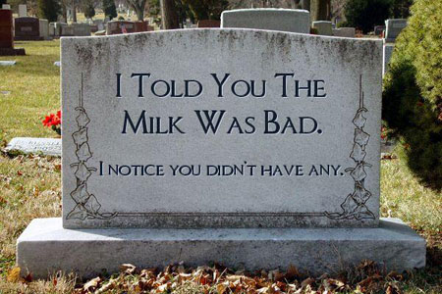
Harriet Hartbyrne
“I don't want anyone to put 'Miss' on my tombstone—
I haven't missed as much as people think!”

Slide 45
Black

Slide 46
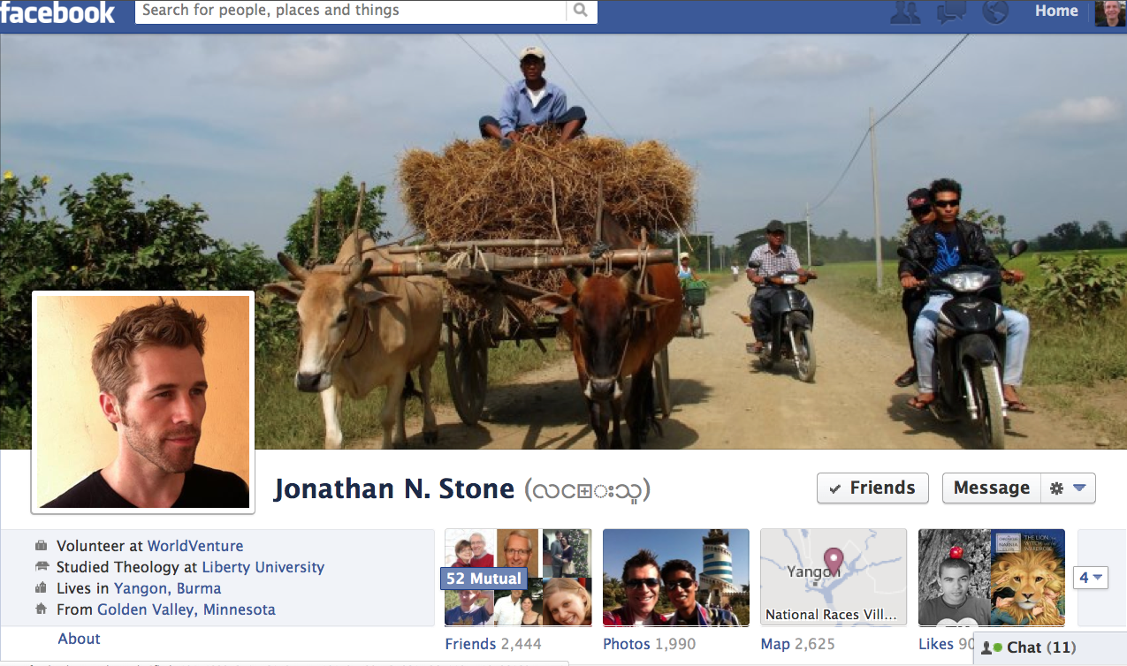
Jonathan Stone

Slide 47

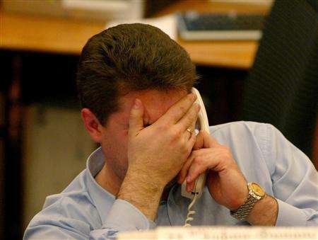
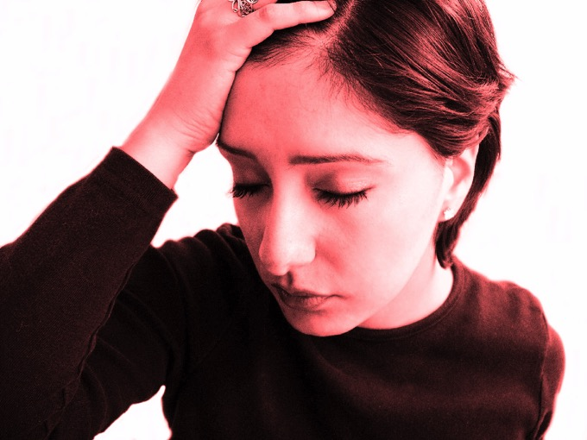
How should marrieds respond to 1 Corinthians 7:25-40?

Slide 48
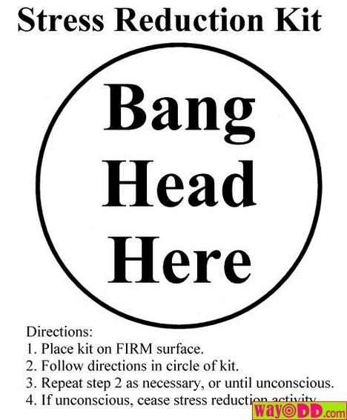
Black

Slide 49
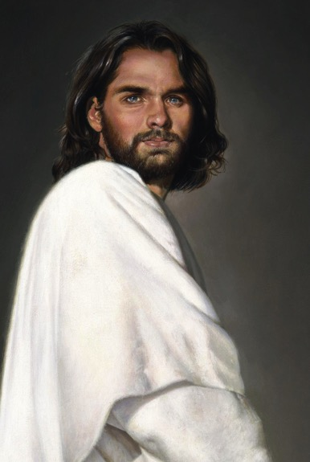
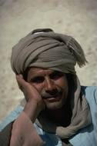
Key NT Singles
Romans 5:12-21
1 Cor. 15:22

Slide 50

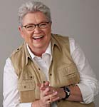
Luci Swindoll
“As a little girl, I always liked the idea of a single lifestyle. I never consciously wanted to marry. I had high goals. I wanted to sing professionally. I wanted to travel. I realized that if I married, I wouldn't have time to accomplish these goals. Also, I thought my temperament needed solitude and was not suited to the responsibilities that marriage and a family required. I didn't think I could blend into my husband with my whole heart. Quite early, God revealed to me that I would be better off not to marry.”

Slide 51
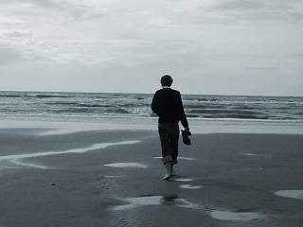
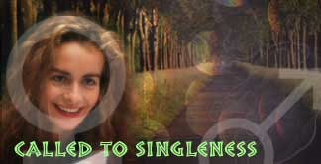
Don't Nag

Slide 52

Contentment
“…is not the fulfillment of
what you want,
but the realization of
what you already have”

Slide 53
Black

Slide 54


NT Preaching link at BibleStudyDownloads.org
Get this presentation and script for free!
Notes:
NT Preaching (np)

